Slide 1


vaidehi dave
AI-Powered Emotion-Based
Music Therapy Assistant
Vaidehi Dave
Name:
Enrollment No:
231433142004
College:
New LJ Institute of Engineering and Technology
Department:
CSE_AIML
Page
01

Slide 2


vaidehi dave
Problem
Statement
•In today's fast-paced world, students often face emotional stress and anxiety.
•There is a need for a digital assistant that can provide emotional support and therapy through music.
Page
02

Slide 3
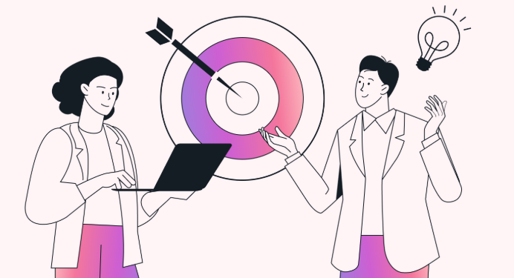
vaidehi dave
Objective
To develop an AI-powered assistant that detects emotional states and recommends personalized music, interactive chats, and games for therapy, focus, and emotional well-being.
Page
03

Slide 4


vaidehi dave
•-Python
•- Streamlit
•- Firebase (Authentication & DB)
•- SQLite
•- Altair (Data Visualization)
•- NLP and Emotion Detection models
Technology
Stack
Page
04

Slide 5

vaidehi dave
System
Architecture
•1. User logs in via Firebase Auth
•2. Inputs feelings (text/voice)
•3. Emotion detected using NLP
•4. System recommends music & chat support
•5. User plays relaxing games and gives feedback
Page
05

Slide 6


vaidehi dave
Core
Features
•- Emotion detection from text or voice
•- Music recommendation based on emotion & goal
•- Chat Buddy with empathetic responses
•- Mood quiz, puzzles, word builder & block blast game
•- Feedback form & journaling
•- Mood history visualization
Page
06

Slide 7
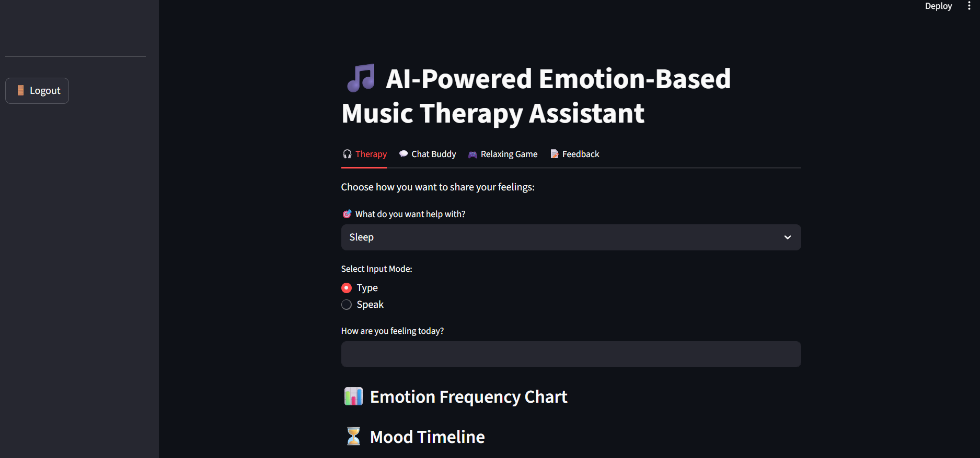
vaidehi dave
Screenshots & UI
Page
07

Slide 8
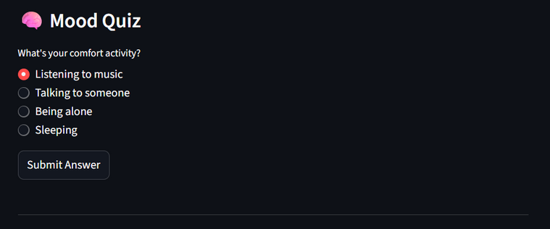
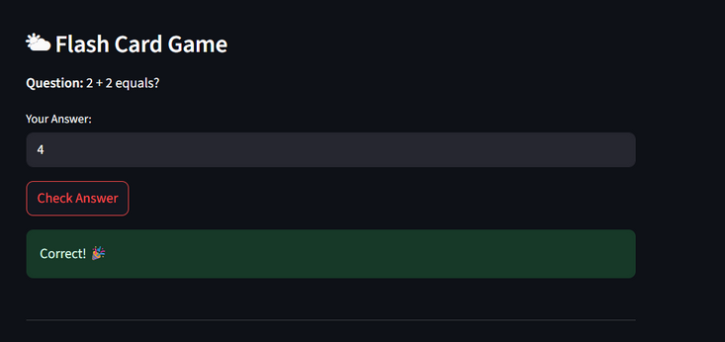
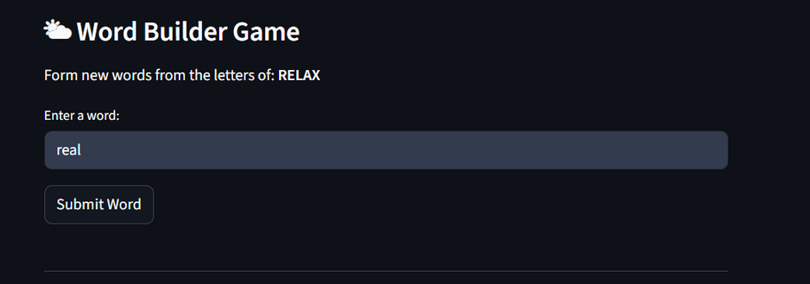
vaidehi dave
Games &
Wellness Tools
Mood quiz
Flash Card Game
Word Builder
Page
08

Slide 9

vaidehi dave
Future Scope
•- Add real-time voice chat & journaling storage
•- More personalized therapy based on user history
•- AI-generated background music
•- Integration with wearable health data
•- Community support spaces
Page
09

Slide 10
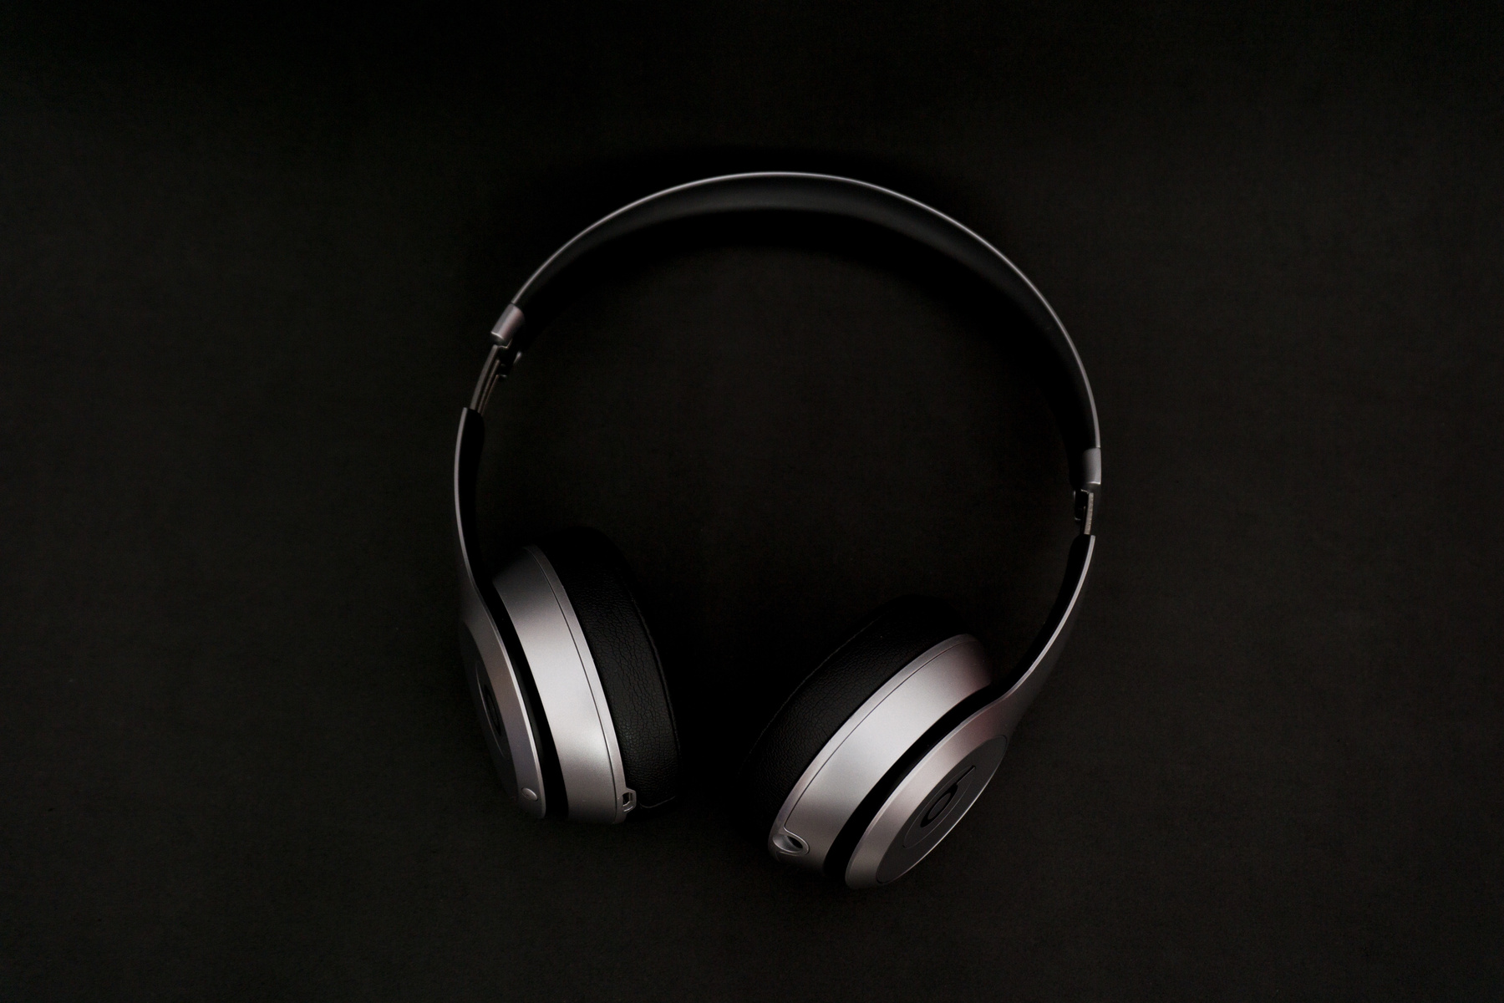
vaidehi dave
Conclusion
•Our app aims to provide emotional wellness using AI.
•It supports users in healing, relaxing, and focusing using music, chat, and games.
•An innovative step toward digital mental health care.
Page
09

Slide 11
vaidehi dave
2024
Thank
You.
Page
10

